Slide 1

Flow betweenness
VinV(G)

Slide 2
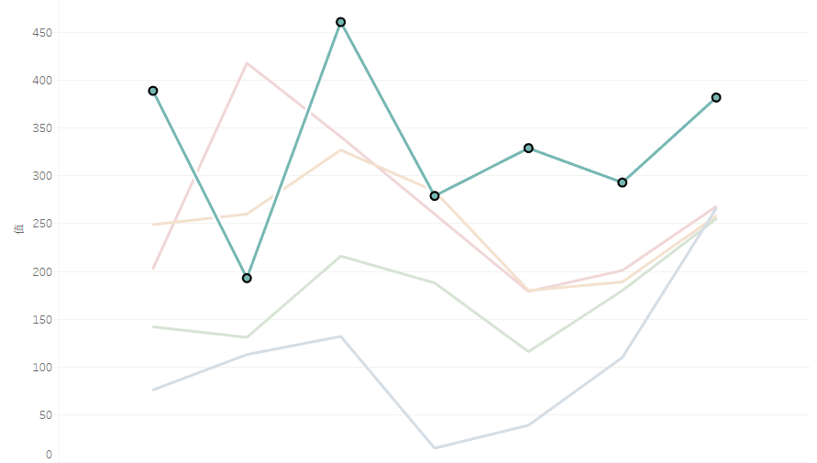
Lakers Flow Betweenness
Set SG for sample
More passes → Game win
Outliers: Game 5 & Game 6
  Analyses
  Reasons

Slide 3
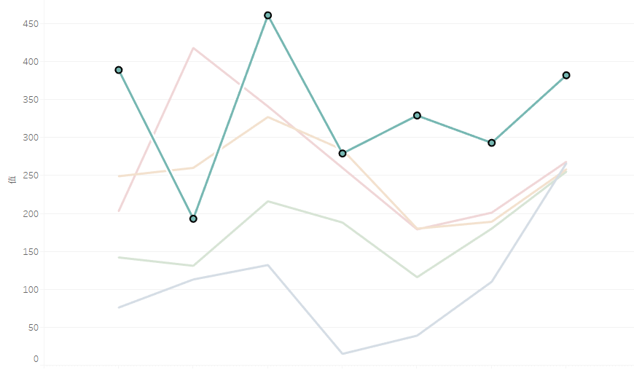
Celtics
Set PG for sample
Less passes → Game win
Outliers: Game 5 & Game 6
  Analyses
  Reasons

Slide 4
Conclusion
What we have done:
  Presented a network for 2010 NBA final,
  Recorded data,
  Analyzed team strategies and individual plays by degree centrality, path length etc.,
  Behaived as our expectation in general.
More discussion:
  It gives a basic view.
  The real game is much more complex.

